Slide 1
Generative AI
By
Shaan Malik, Jade Matzel, Arya Mazandarani, Jasmin Rutter

Slide 2
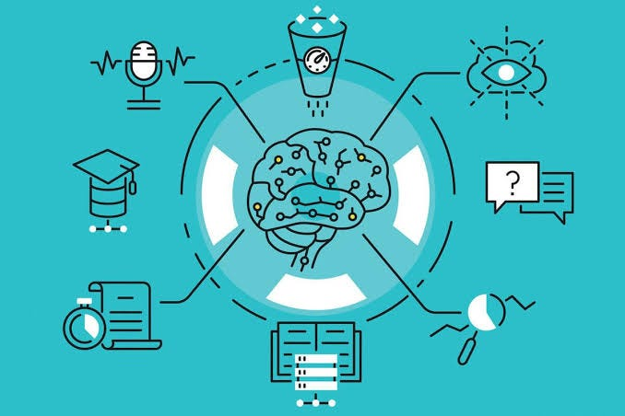
What is Generative AI?
New Content is Created
Systems learn patterns from datasets
Able to adapt to different tasks
Output is targeted and controlled
Used in various fields
Art
Finance
Natural language
Data science

Slide 3
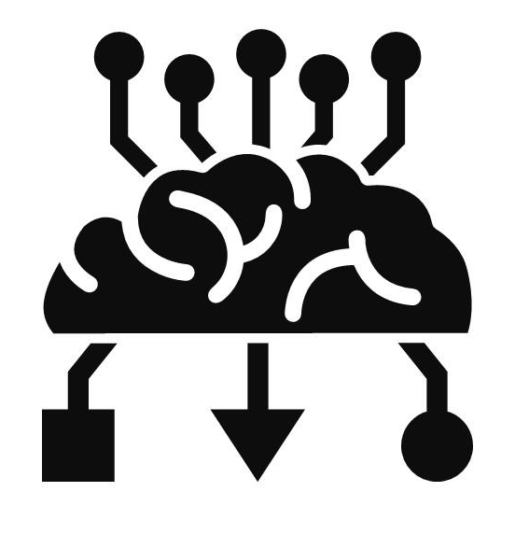
Generative AI Models
Generative Adversarial Networks (GANS)
Generates data & distinguishes what's real & fake
Variational Autoencoders (vaes)
Generates new samples from learned data
Autoregressive Models
Predicts the probability distribution of next element
Recurrent Neural Networks
Process sequential data & predicts next element in sequence
Transformer-Based Models
Attention based models relationships between different elements
Reinforcement Learning
Improves tasks through trial and error

Slide 4
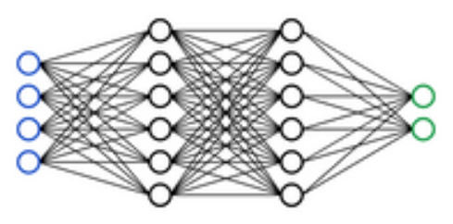
How Generative AI Works
Neural Networks
Input
Hidden
Output
Training data
Looks for patterns
patterns “train” network
more data +larger network = better output

Slide 5
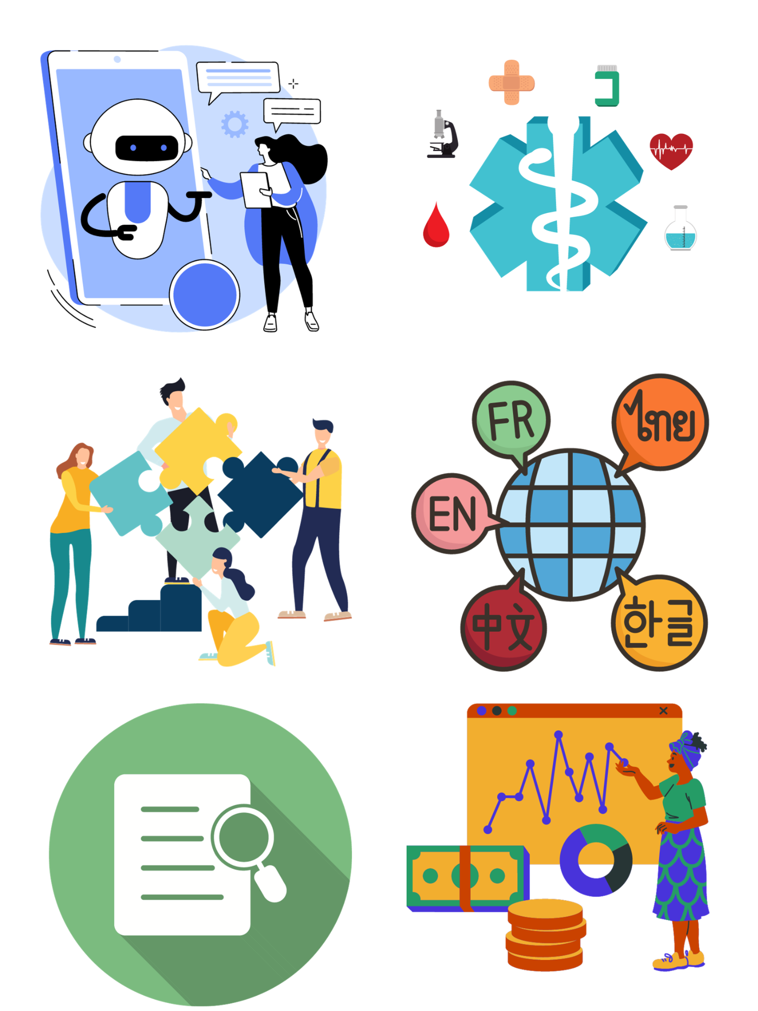
Applications of Generative AI
Text generation
chatGPT
Note Taking
Code development
Image generation
Dall-E
3D Models
Automation
robots learn to do “skilled tasks” based on training data
Form automation for large companies/government agencies
Auditory
Generate music
Generate voices

Slide 6
Challenges
One challenge that runs rampant throughout the Technology industry in general is scalability.
Scaling AI by giving it massive data sets can be extremely challenging
Not to mention EXPENSIVE
According to Gartner, a management consulting company, about 53% of their AI prototypes actually end up being used in production
Another challenge is hardware limitations
AI can be trained for eternity
It is demanding and expensive to run

Slide 7
Potential Downsides for Humans
With Generative A.I having so much potential to take over in many different industries, there will be a lot of jobs that will be taken by A.I. (Ex - Artist, Writer, Content Creation, programmers, repetitive tasks, etc…)
Generative A.I has the potential to be a lot more productive than humans, this can result in a lot of layoffs from companies that realize that there is not much of a need for human workers when A.I can do much better for cheaper.

Slide 8
Generative AI in Healthcare
Pros:
AI can summarize mass data and spot abnormalities
Can also be used to automate simple and mindless tasks
This gives doctors and physicians more focus on more important tasks
AI can compare data of patients with other patients to spot stark differences
Cons:
Still in development, therefore risky
Expensive
Sensitive information susceptible to leaking

Slide 9
Natural Language Processing
Natural Language Processing is the process of AI using a set of algorithms to process English text and interpret it into code to be able to act upon it and create a response.
Ex: ChatGPT uses NLP to process your question, translate it into machine language, then translate its response from machine language back to english.
Natural Language Processing is used in:
Chat box responses
Spam detection
Text-to-speech and speech-to-text translation

Slide 10
Case Studies
Generative A.I is being used by researchers in drug discovery. This means that the A.I can find useful properties in the molecular structure to help solve real world problems.
It can also be used in educational institutions to help students learn and cater to their individual needs
Generative A.I can generate legal contracts based off of each parties agreed terms.
Generative A.I is already being used in image and text generation.
Notes:
Generated Legal Contracts would help save a lot of time and effort and overall make things easier.
Image and Text generation are obviously useful in many ways like using the A.I to write articles, marketing for ads and coding. Or generate images to give inspiration to artists to see what kind of art they would like to make.

Slide 11
Future Trends
Generative A.I can potentially in the future be used by animation studios like disney to help create movies or tv shows by just typing in what they would like to see
It can also be used in the future by gaming companies to generate content for the game like animations, cutscenes, or the entire game itself.
There will be more content that will be generated using generative A.I across all different type of social media platforms and other industries.
Notes:
The content could include things like educational videos, entertainment, new stories, scripts, poems, art, etc…

Slide 12
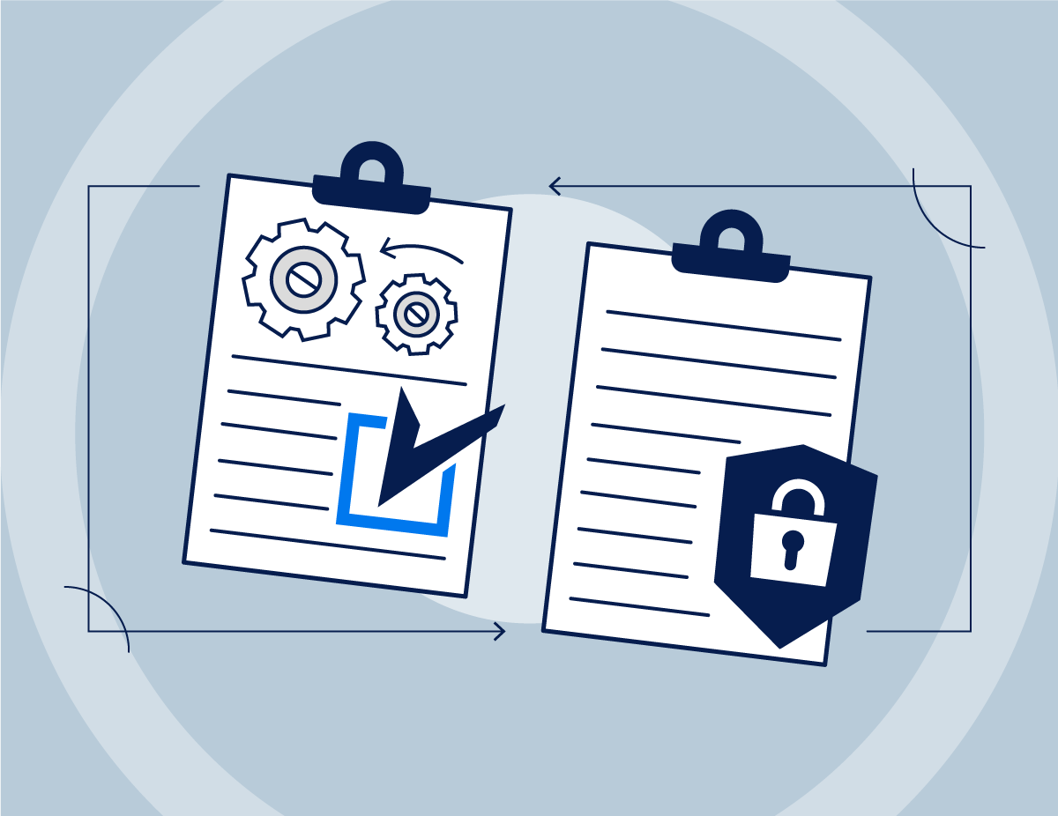
Policy Suggestions for Job Reduction
Job Retraining Programs - These retraining programs would help workers adjust to this rapidly changing environment and use technology related to Generative A.I.
Career Counseling - These services would be easily available for workers whose jobs have been eliminated by automation from A.I. They would help workers make decisions about their future career paths and the best option to take
Educational Programs - These programs would bring education to individuals of all ages to learn everything they need to know about A.I.

Slide 13
Policy Suggestions for Personal Data
Ownership of Data Rights - These rights would grant ownership of data to individuals and their personal data. This would prevent others stealing data to train A.I models.
Accountability Laws - These laws would hold companies and organizations accountable for their actions regarding their use of generative A.I and their potential misuse of data

Slide 14
Policy Suggestions for Industries
Guidelines for Ethical A.I use - These guidelines would make sure that A.I systems are being made and used in a responsible and ethical manner. This would include things like : avoiding bias and discrimination.
Enforce Transparency - This requirement would ensure that companies are transparent when their A.I is being used in whatever they may be showing to their users. They would have have to communicate to users publicly on what is specifically A.I Generated.
Mandatory Information Sharing - This requirement would encourage companies/organizations to share information regarding generative A.I (Ex: Lessons Learned, things to avoid, etc..)

Slide 15
Why are these Policy Suggestions Important?
These policy suggestions are important because they would ensure that the rapid growth of Generative AI is a benefit to society and minimizes the possible negative effects of Generative A.I

Slide 16
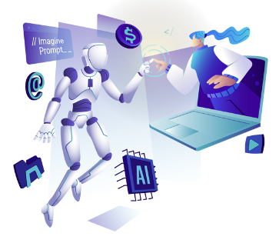
Conclusion
All in all, Generative A.I has been shown to be extremely powerful and has a lot of potential to change the world significantly.
Currently, Generative A.I is still a newer technology and there is still lots of room for improvement.
You can expect a lot more industries to be using Generative A.I for their everyday tasks.

Slide 17
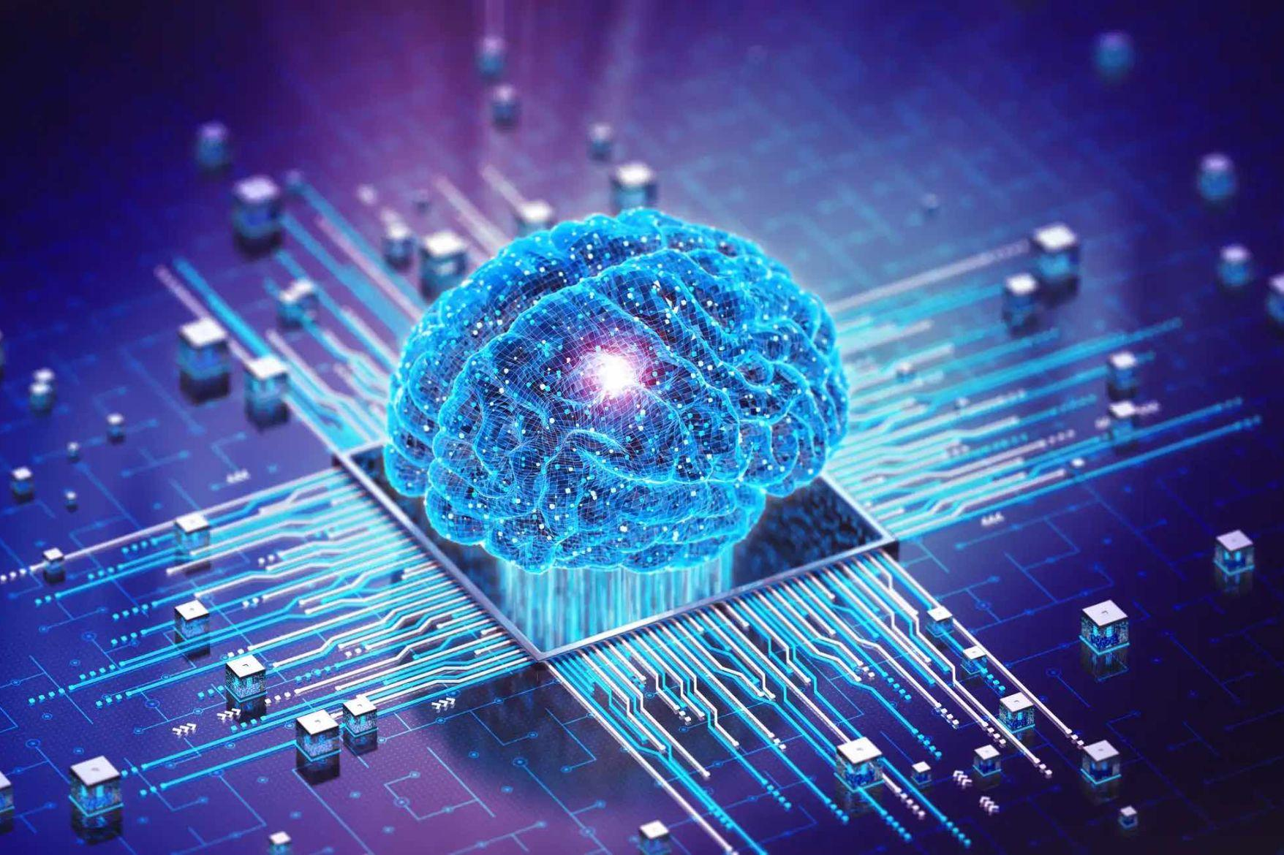
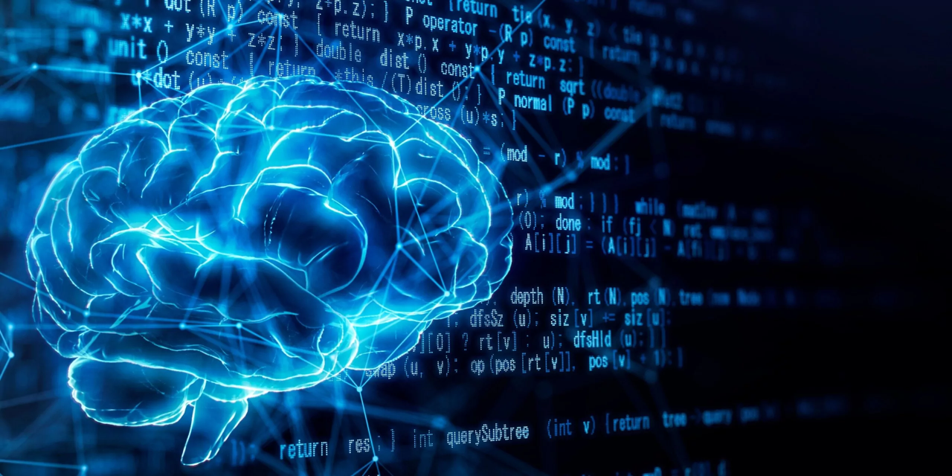
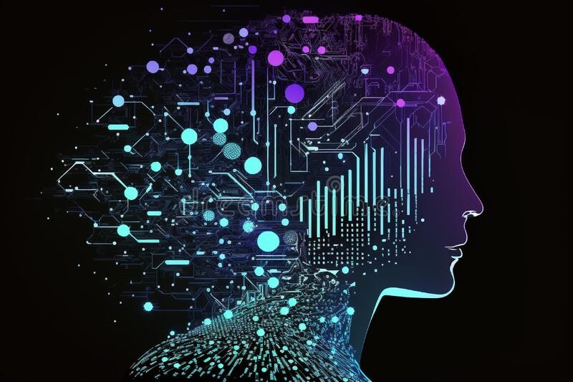
Questions?

Slide 18
References
Bhasker, Shashank, et al. “Tackling Healthcare’s Biggest Burdens with Generative AI.” McKinsey &amp; Company, McKinsey &amp; Company, 10 July 2023, www.mckinsey.com/industries/healthcare/our-insights/tackling-healthcares-biggest-burdens-with-generative-ai.
Data 360 Network. “Generative AI and Natural Language Processing: Applications and Challenges.” Medium, Medium, 25 Feb. 2023, data360network.medium.com/generative-ai-and-natural-language-processing-applications-and-challenges-3ae5ec254fdc.
Klubnikin, Andrei. “Top 5 AI Challenges &amp; How to Overcome Them.” ITRex, 21 Sept. 2023, itrexgroup.com/blog/artificial-intelligence-challenges/.
Mangtani, Ashley. “Everything You Need to Know about Generative AI.” Medium, Medium, 18 Feb. 2022, ashley-mangtani.medium.com/everything-you-need-to-know-about-generative-ai-849ffb41e695.
Porter, Alexis. “Unveiling 6 Types of Generative AI.” BigID, BigID, 20 Nov. 2023, bigid.com/blog/unveiling-6-types-of-generative-ai/.
SAS. “Natural Language Processing (NLP): What It Is and Why It Matters.” SAS, 2023, www.sas.com/en_us/insights/analytics/what-is-natural-language-processing-nlp.html.
SoluLab. “Top 25 Generative AI Use Cases in 2023.” Blockchain Technology, Mobility, AI and IoT Development Company USA, Canada, Solulab, 9 Nov. 2023, www.solulab.com/top-generative-ai-use-cases/#Generative_AI_Use_Cases.

